Slide 1
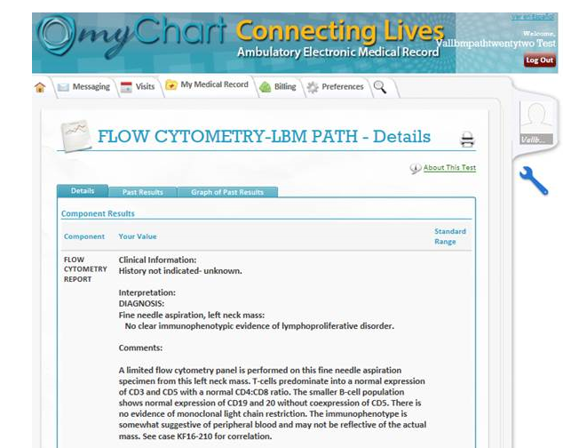
LBM Pathology Medical Group
EPIC News Flash
February 8, 2017
Talking Points
How do I add on testing?
Call Client Services at 562.989.5858
If original specimen:
Is less than 30 days, verbal order accepted
Is greater than 30 days, a new order is required
Note: Molecular specimens are stored for 30 days and testing can be added.
How long will faxes and hard copy results continue?
Faxes will remain on for 1 week
Hard copy results will continue for 1 week.
After 1 week, hard copies will be received for Referral Testing only
What is considered Referral Testing?
Stone Analysis and Cultures with biopsies
Can my patients access these results on MyChart?
Yes
Client Services: phone: 562.989.5858 fax: 562.989.5860 www.lbmpath.com

